Slide 1
HOSPITALITY STUDIES GRADE 10
SECTORS AND CAREERS

Slide 2
ESTABLISHMENTS IN THE HOSPITALITY INDUSTRY
COMMERCIAL FOOD SERVICES
Operate for profit
Hotels
Restaurants
Motels
Take Aways & Fast Foods Outlets
Coffee shops
Tuck shops
NON-COMMERCIAL FOOD SERVICES
Subsidised by the government
Hospital canteens
Relief Agencies: Red cross & Salvation Army
Armed forces
School tuck shops
Prison canteens

Slide 3
SIX COMMERCIAL FOOD SERVICE SECTORS
Accommodation Sector
Food and Beverage Sector
Entertainment Sector
Hospitality Sectors
Functions and Events Sector
Gaming Sector
Recreation Sector

Slide 4
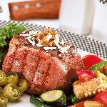
Food and Beverage Sector
SERVICES
Sell and serve variety of food and beverage products
They make tasty meals and drinks from raw ingredients
Products are sold in an attractive environment

Slide 5
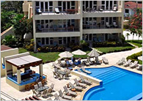
Accommodation Sector
SERVICES
Provides accommodation but can also provide food and other services
A place where tourist stays temporary and a fee is charged.

Slide 6
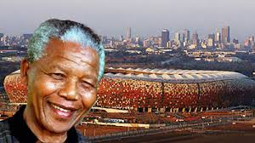
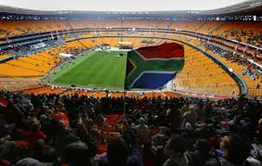
Entertainment Sector
SERVICE
Food and Beverage products and services are sold for profit
Venues include theatres, clubs and stadiums.

Slide 7
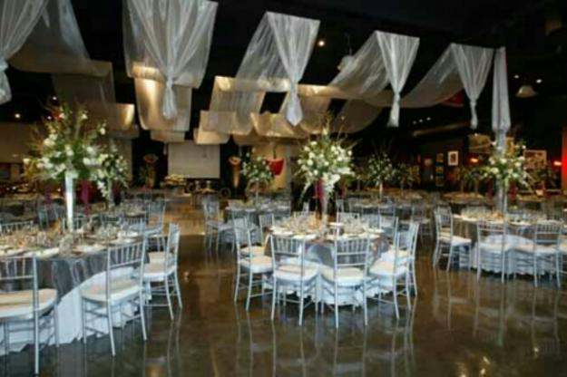
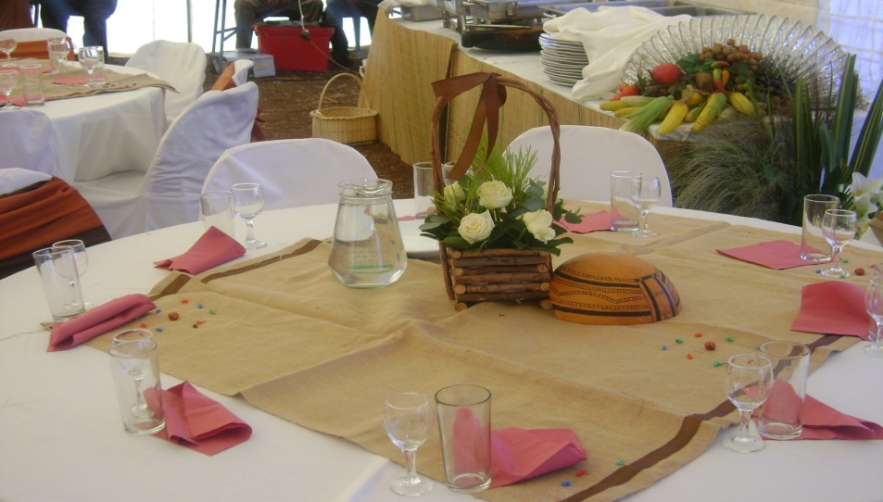
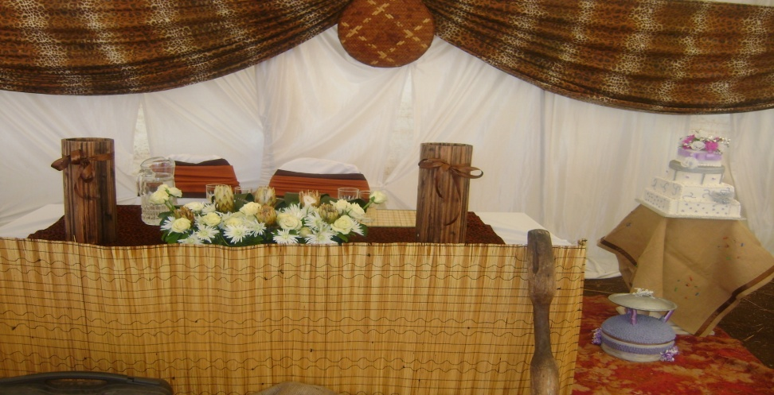
Functions and Events Sector
Provide for corporate functions, weddings and conferences.
Services include food, beverages and accommodation.
Additional services may include planning, organisation and management of functions or events.
SA is famous destination for conferences.

Slide 8
Recreation Sector
SERVICE
Sell health foods or
Dietary foods and beverages
Venues include sports clubs, health and fitness centers.

Slide 9
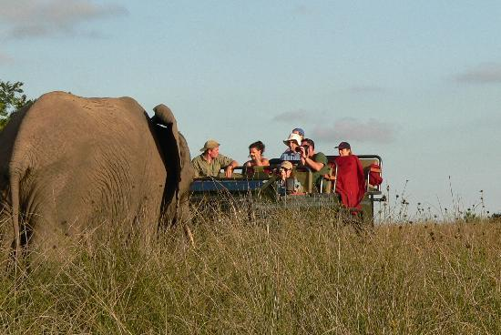
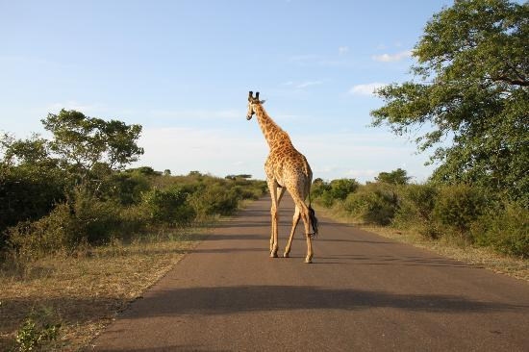
Gaming Sector
SERVICE
Hospitality products and services and gaming services.
Aim to give guests comfort
Services include accommodation, room service, food and beverages, valet service, laundry service and recreation.

